Slide 1
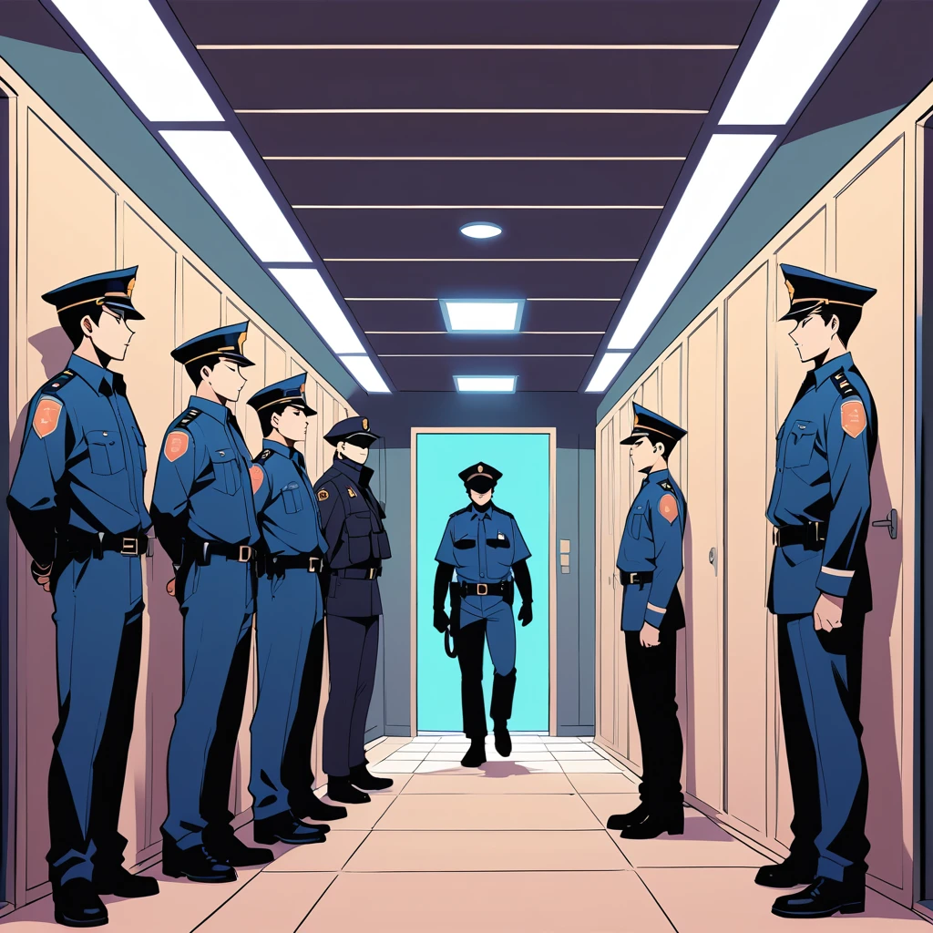
MY FIRST DAY AT WORK
POLICE OFFICER

Slide 2
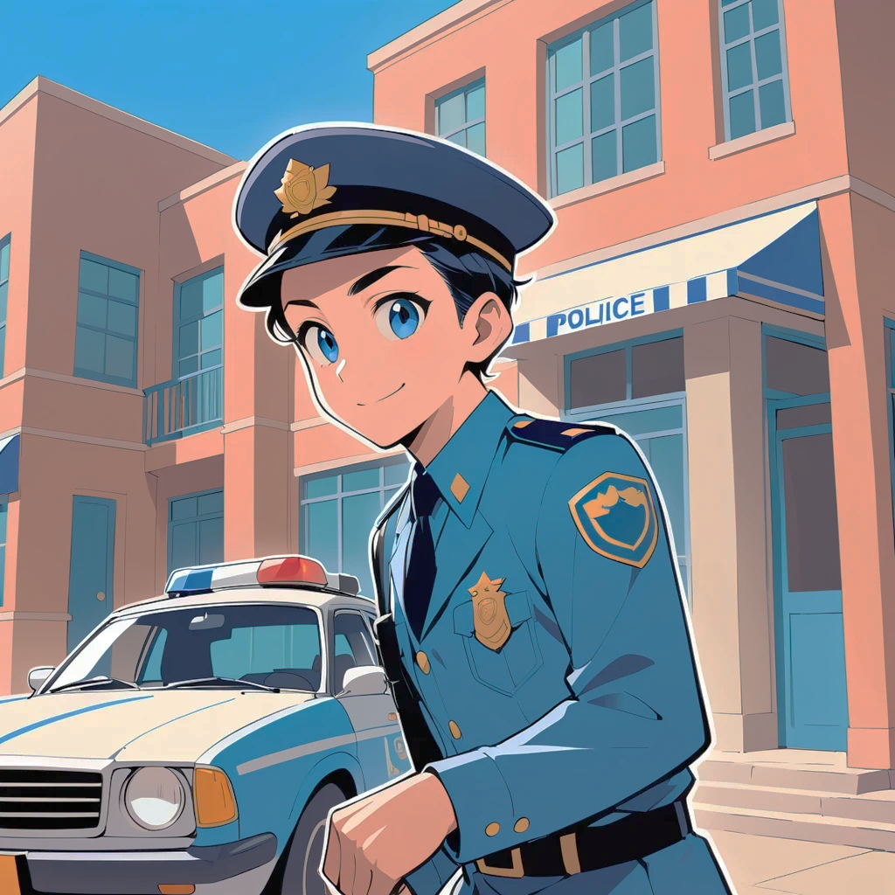
MY FIRST DAY AS A POLICE OFFICER
I ARRIVED EARLY THAT MORNING. I LIKE TO ALWAYS BE ON TIME
I WAS NERVOUS AND EXCITED AT THE SAME TIME. FIRST DAYS CAN BE KIND OF OVERWHELMING

Slide 3
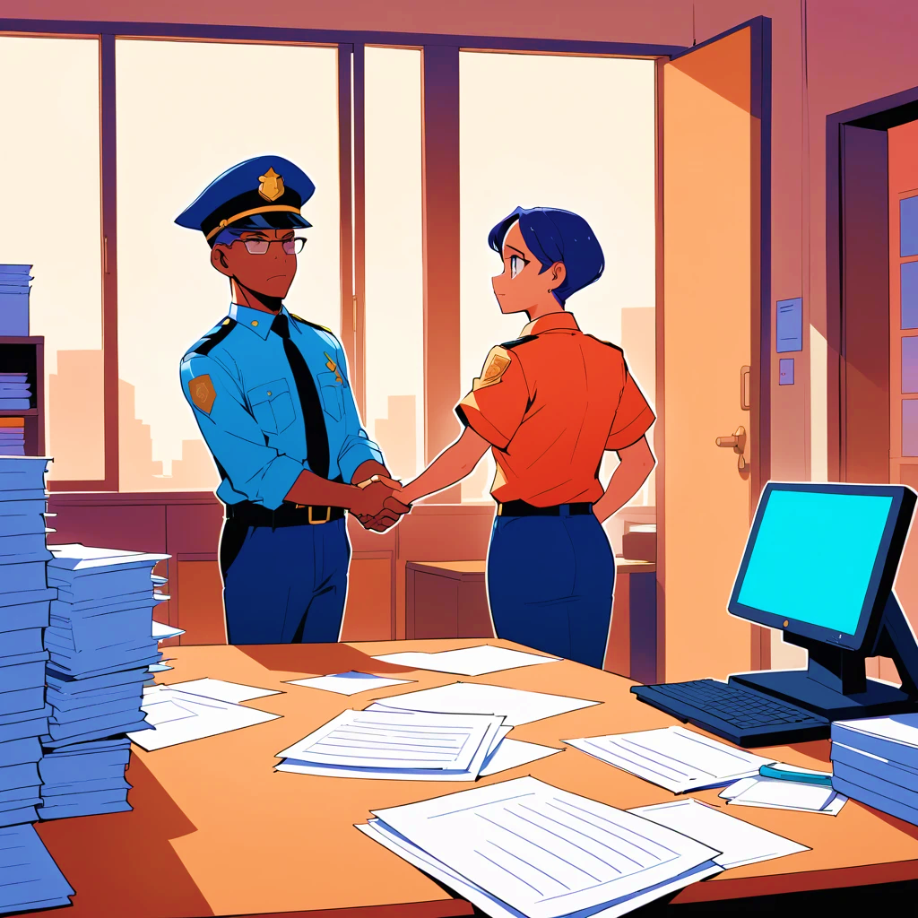
THE FIRST THING I DID WAS TO INTRODUCE MYSELF TO CHIEF OFFICER WILKINS
I DONT CARE TO MUCH ABOUT FIRST IMPRESIÓN. BUT THIS MAN WAS POLITE, SERIOUS AND DIRECT

Slide 4
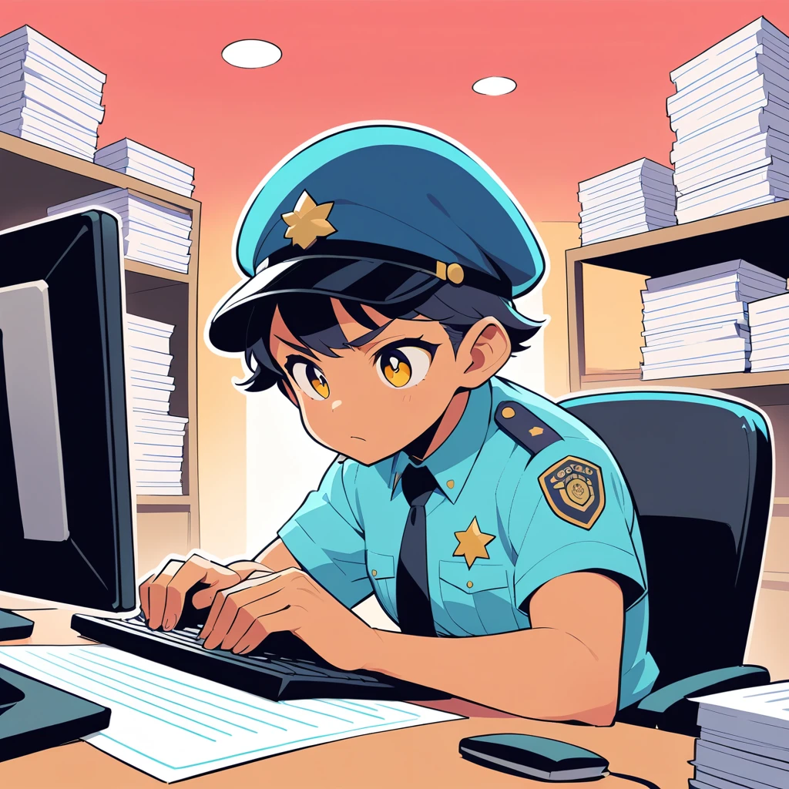
MY FIRST ASSIGNMENT WAS TO HELP FILL OUT SOME DOCUMENTS. THERE IS A LOT OF PAPERWORK TO DO HERE.
I WAS ALSO ANSWERING CALLS ALL THE MORNING. FOR HELP, EMERGENCIES. ALL KIND OF STUFF.

Slide 5
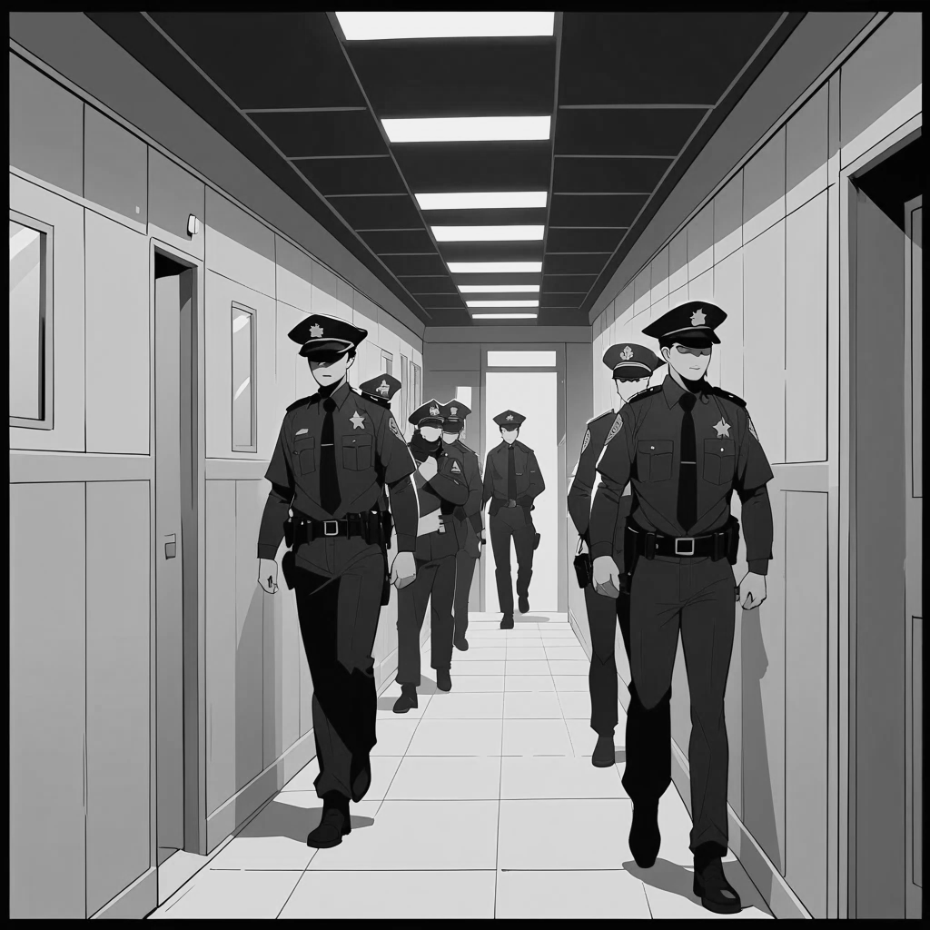
THERE ARE LOTS OF PEOPLE WORKING HERE. IS DIFICULT TO REMEMBER ALL THE NAMES
I SAW TWO COLLEAGUES ARRESTING A THIEF IN MY FIRST DAY. WHAT A DAY.

Slide 6

IN THE AFTERNOON I WENT ON PATROL WITH OFFICER ANDREWS. IT WAS A GREAT DAY. I AM EXCITED WITH ALL THE THINGS I HAVE TO LEARN
CHIEF SAID THAT I WAS ORGANIZED AND DISCIPLINED. NICE!! NOW I CAN GO HOME AND RELAX LISTENING MUSIC

